Slide 1
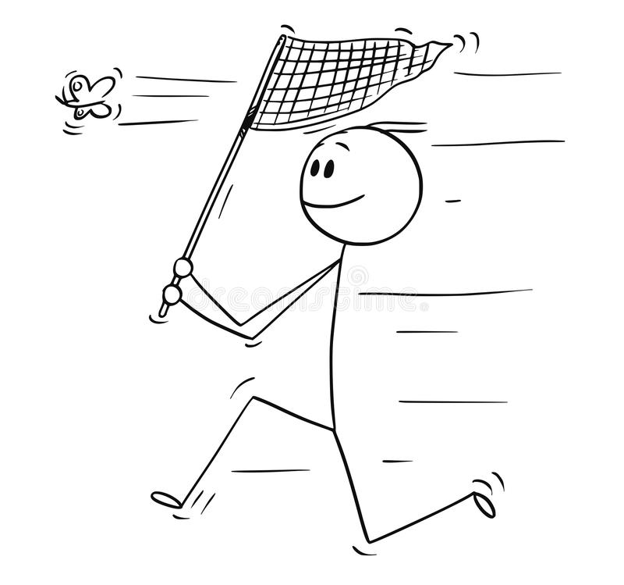
FIELD PREP 2022
Julian Wittische – Alain Frantz 2022

Slide 2
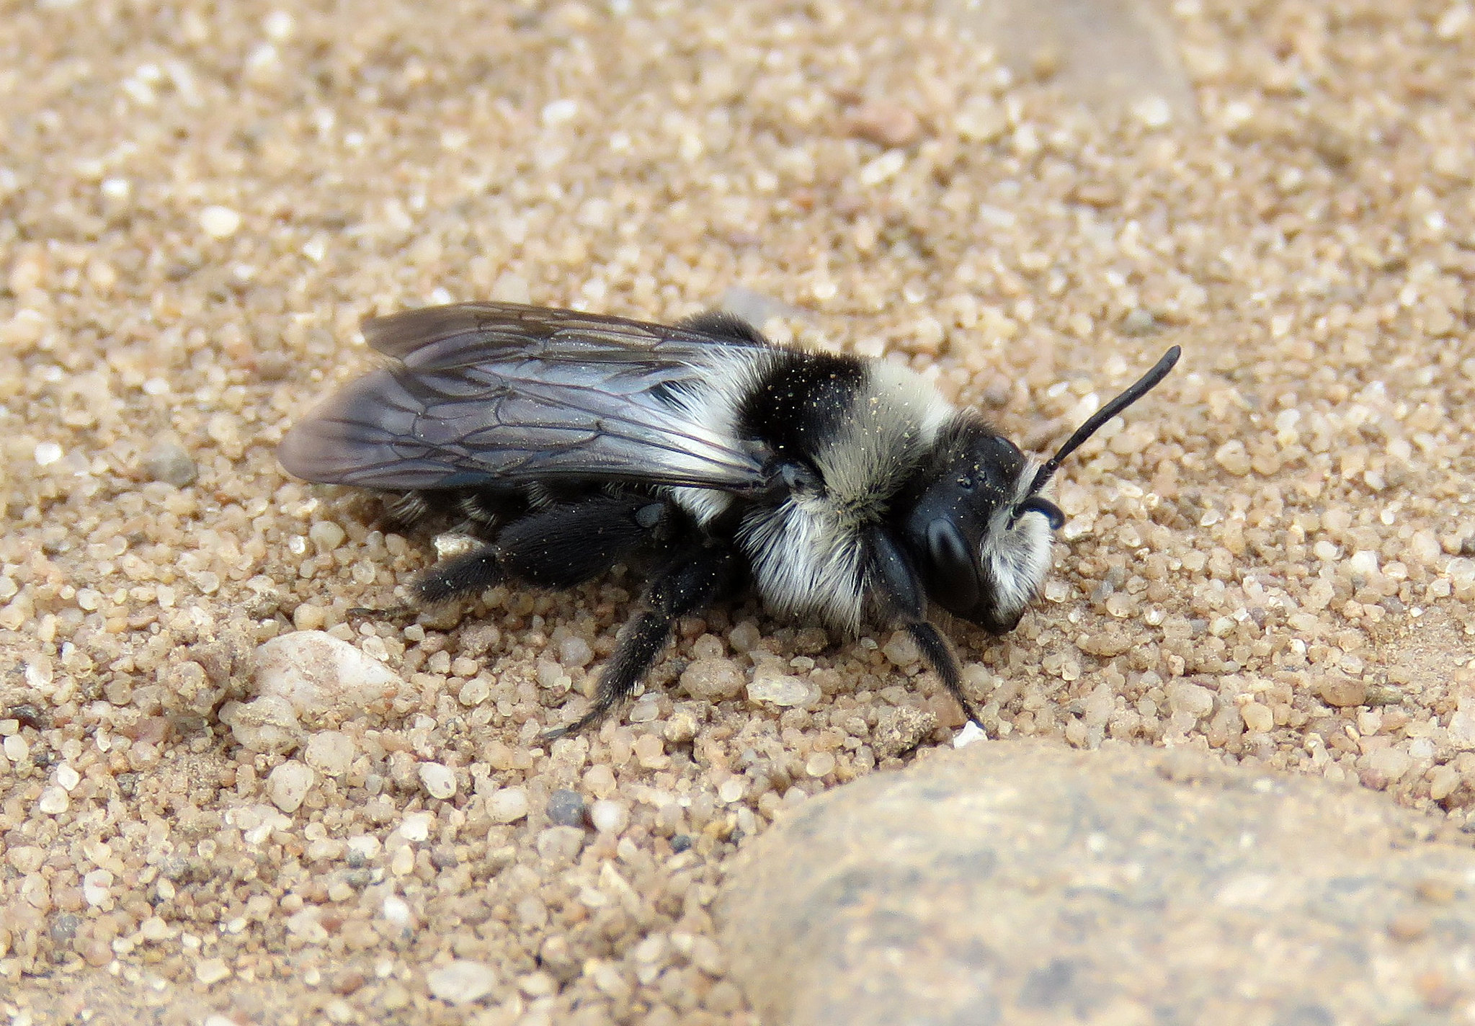
Andrena cineraria - Female

Slide 3
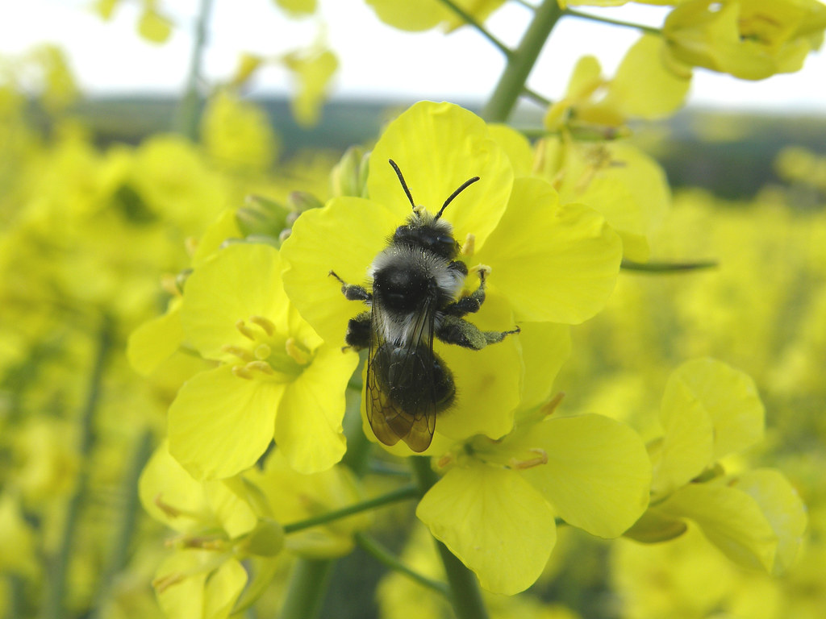
Andrena cineraria - Female

Slide 4
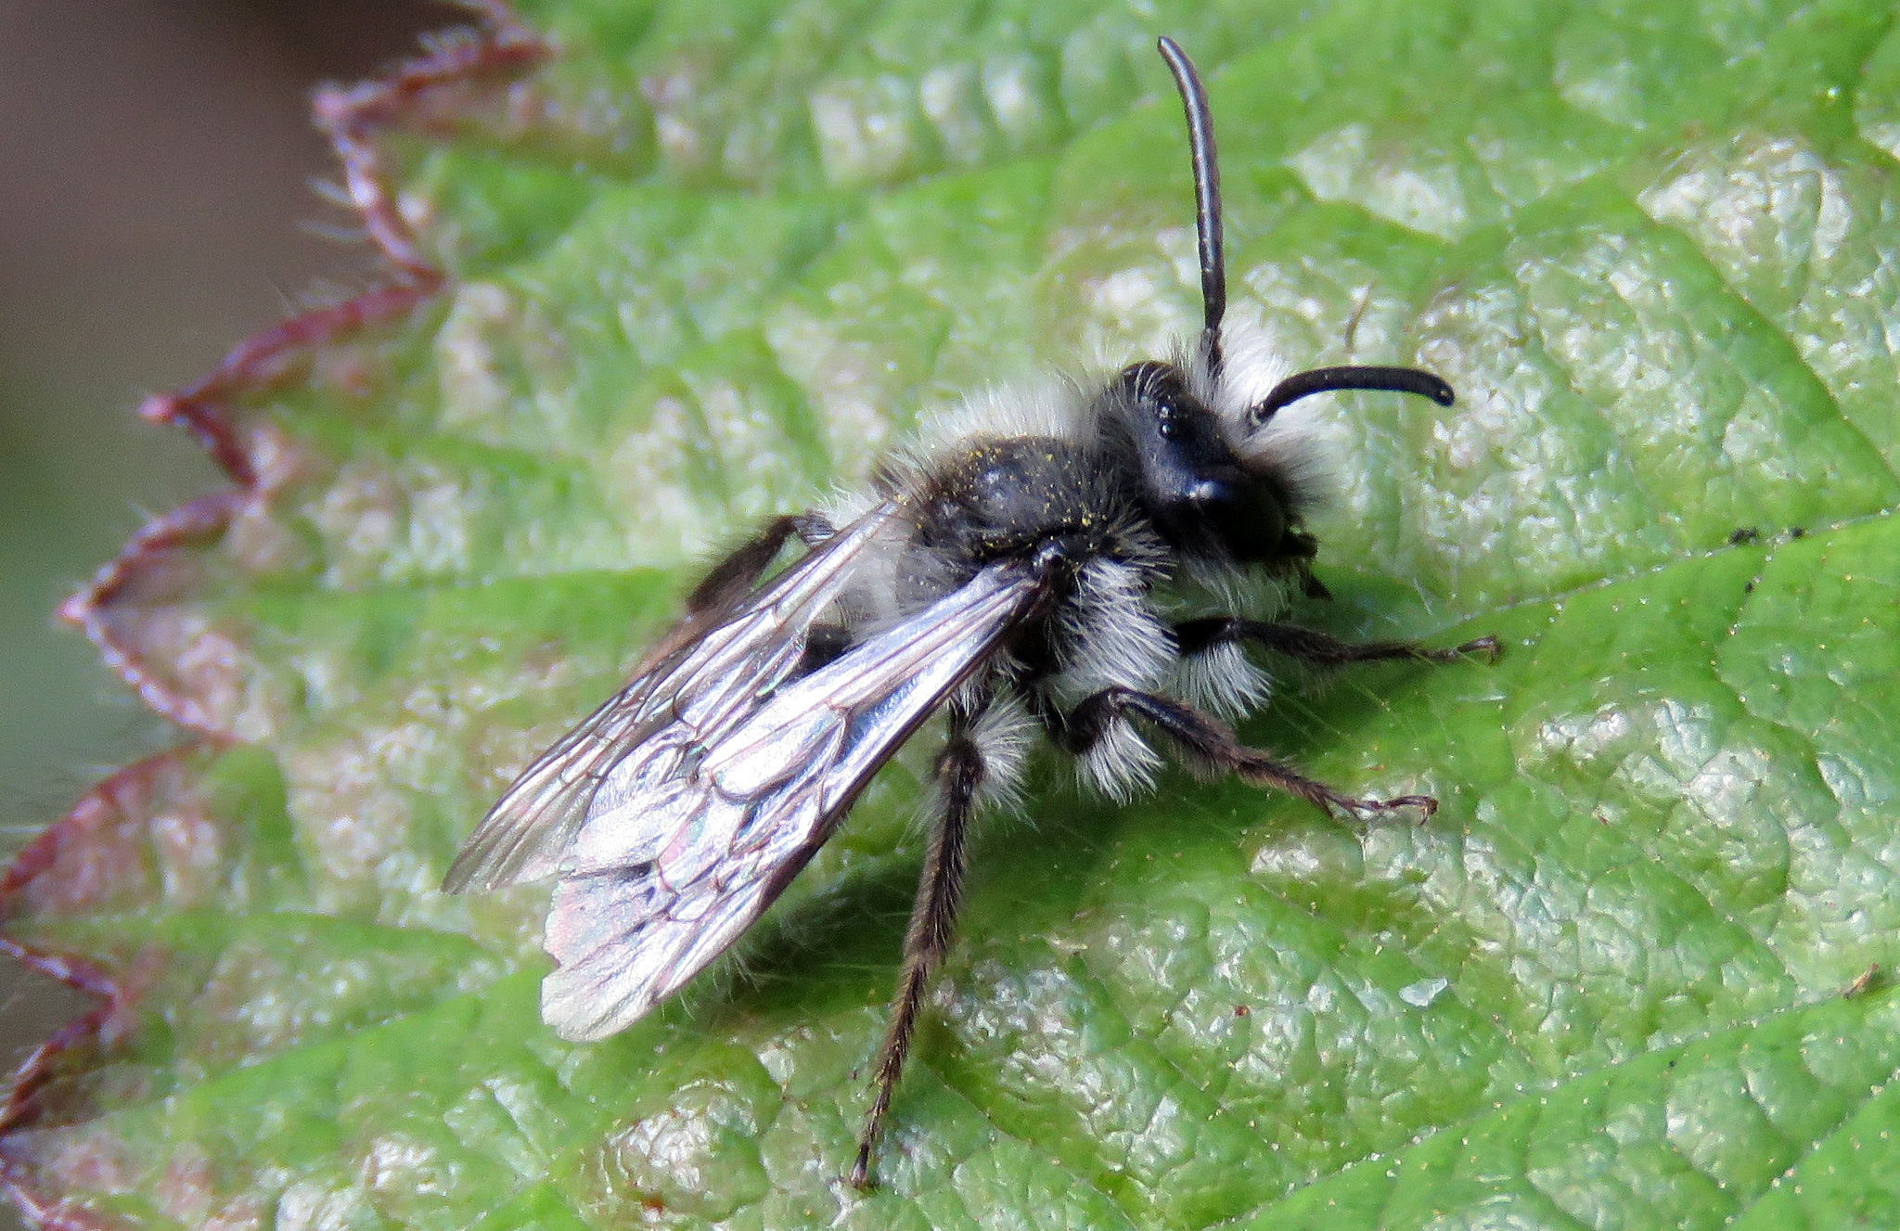
Andrena cineraria - Male

Slide 5
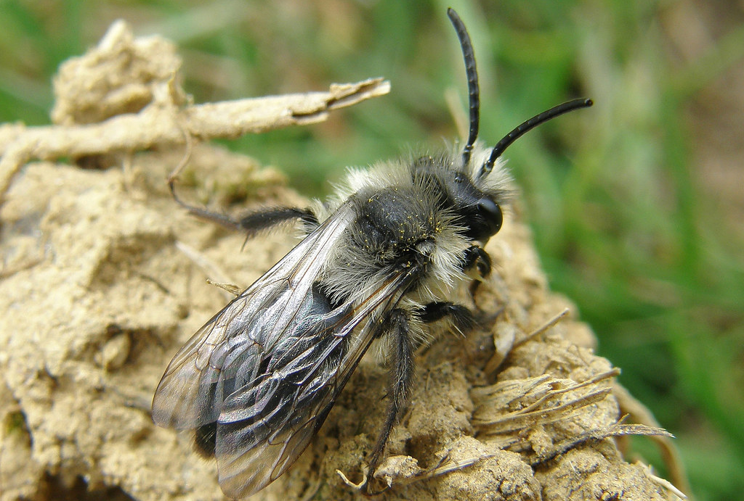
Andrena cineraria - Male

Slide 6
Andrena cineraria - Males vs Females
Females have broad dorsal stripes of dense white hair at the anterior and posterior parts of the thorax
Males have denser white hairs on the side of the thorax but uniformly and more sparsely distributed white hairs on the dorsal part
Males are smaller

Slide 7
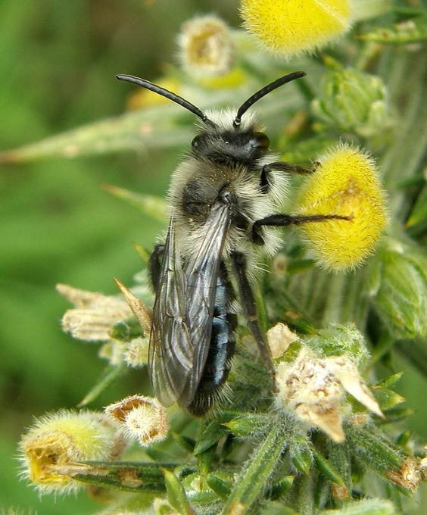
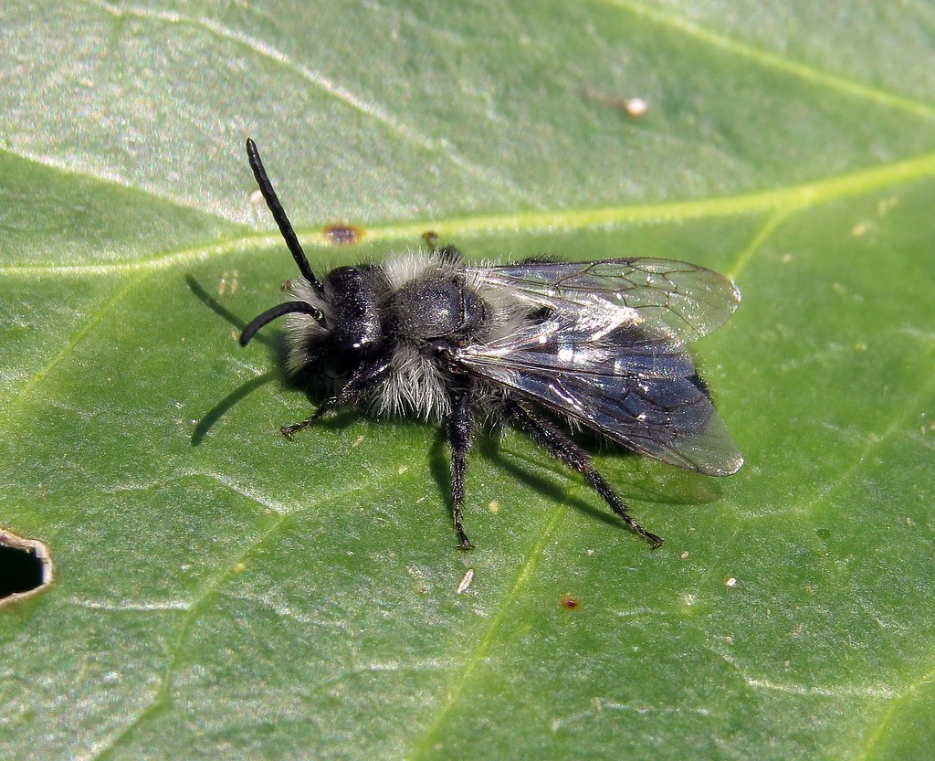

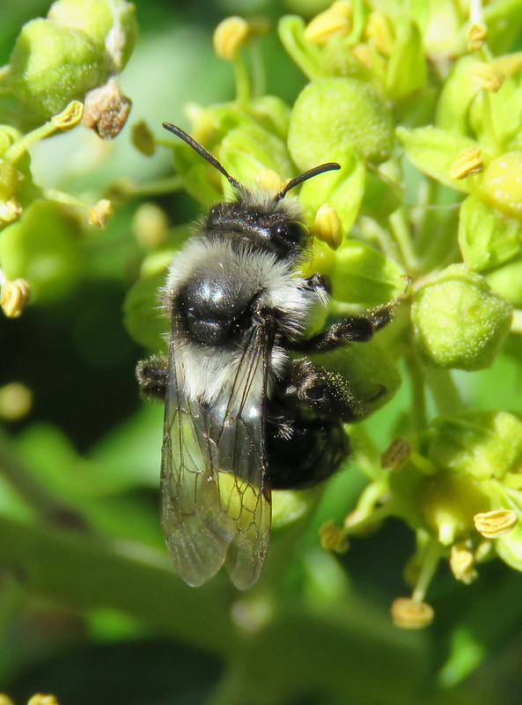
Andrena cineraria - Males vs Females Quizz

Slide 8
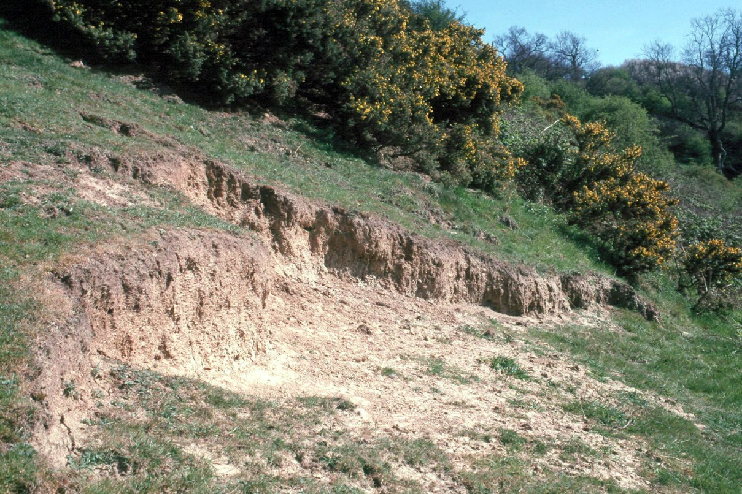
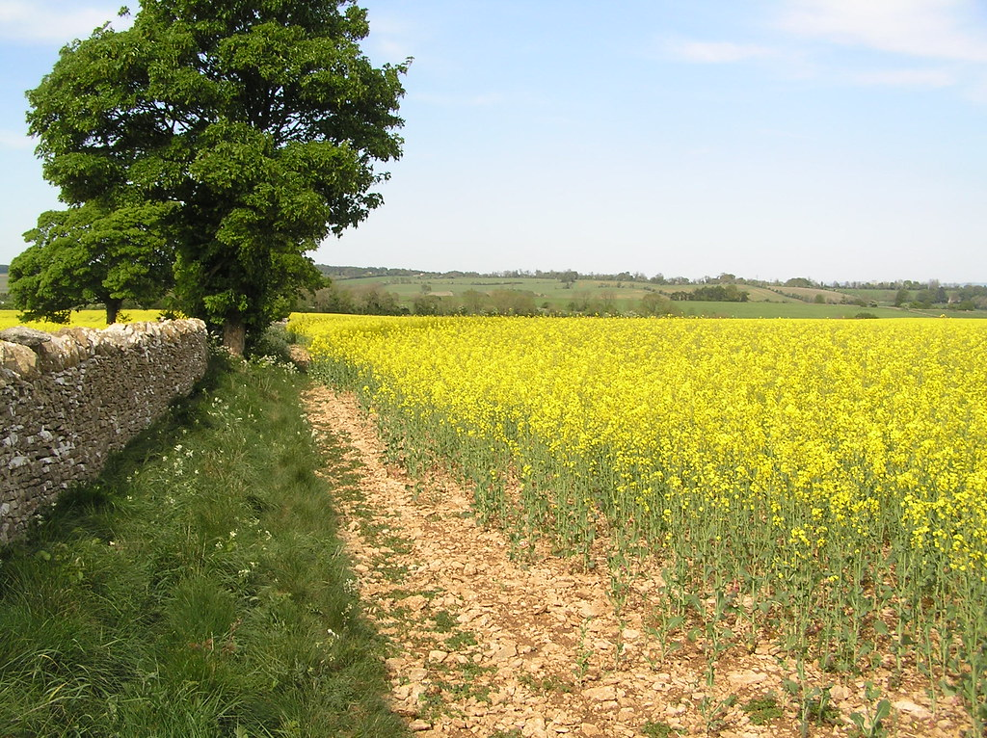
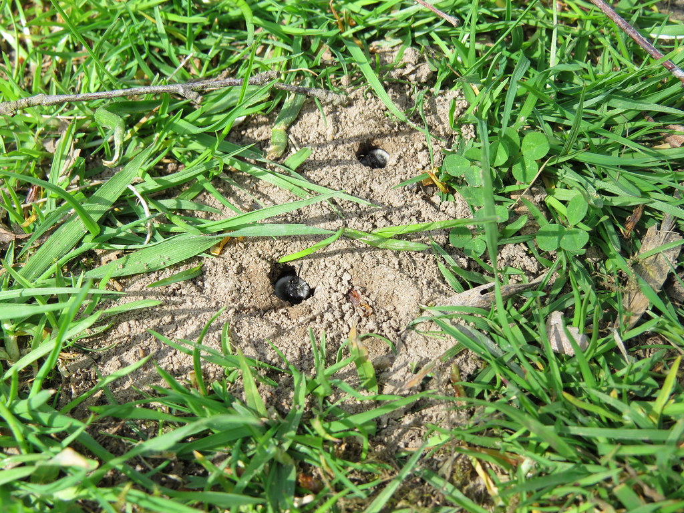
Where?

